Slide 1



Hands-on session: SWGO optimization
ALPACA workshop - Trento, November 21, 2023
Tommaso Dorigo, INFN Padova

Slide 2
Abstract of hands-on session
Deep learning may require one to develop a fully differentiable model of a problem in order to exploit the properties of differential calculus and perform, e.g., gradient descent and training of neural networks. There are various tools for this task, available in PyTorch, TensorFlow, etcetera.
However, not all operations are differentiable; and even when they are, sometimes we need to cook up approximated calculations. In this hands-on session we will consider an optimization pipeline for a cosmic ray observatory, and look at two such problems.
The first – which *could* be worked out within the time of the lecture – is to find a way to produce a differentiable model of a non-differentiable triggering condition.
The second – left as an offline exercise – is to implement in a differentiable pipeline for optimization the delta method for the calculation of the uncertainty on a likelihood ratio test statistic

Slide 3
Differentiability
γ
In the simulation pipeline for the SWGO optimization, everything needs to be differentiable if we are to navigate the parameter space with gradient descent.
One of the “realistic” conditions we had to implement was the one concerning the reconstruction of showers: in real life, we require to have at least a few detector units recording a signal in order to consider the event as reconstructable and valid.
The number, call it N_{tr}, could be of the order of 10-30 units in coincidence

Slide 4
What the N>=N_{tr} threshold does
γ
If we disregard showers that produce secondaries in too few detectors, we are going to estimate the utility using a subset of the batch events. That is fine… But the subset may change!
In fact, when we move a detector unit to follow the gradient of U, the move could bring under threshold some of the considered showers, or bring over threshold rejected showers. This would affect the utility in a way that the derivative knows nothing about!
To overcome this problem, we need include in U and dU/dx the effect of the (discrete, non differentiable) selection N>=N_{tr}, by producing an “analytical continuation” in the reals of the number of hit tanks.

Slide 5
What the N>=N_{tr} threshold does
γ
If we disregard showers that produce secondaries in too few detectors, we are going to estimate the utility using a subset of the batch events. That is fine… But the subset may change!
In fact, when we move a detector unit to follow the gradient of U, the move could bring under threshold some of the considered showers, or bring over threshold rejected showers. This would affect the utility in a way that the derivative knows nothing about!
To overcome this problem, we need include in U and dU/dx the effect of the (discrete, non differentiable) selection N>=N_{tr}, by producing an “analytical continuation” in the reals of the number of hit tanks.

Slide 6

The Utility and the problem with triggering
The SWGO optimization utility function is made up of two terms:
U₁ = φ_{γ}/σ_{φγ}
is a term that assesses how precisely we measure the flux of photons;
$U_{2}=\frac{\sum_{i=1}^{N_{batch}}{\left[I_{γ,tr}w(E_{γ,t}^{i})\frac{E_{γ,t}^{2}}{\left(δ^{2}+{\left(E_{γ,t}−E_{γ,m}\right)}^{2}\right)}\right]} }{\sum_{i=1}^{N_{batch}}{\left[I_{γ,tr}w(E_{γ}^{i})\right]}}$
appraises the precision of the energy measurement E_{γ,m} for photons in a batch.
If we change the indicator I_{γ,tr} for an event because it fails the triggering condition, U₂ changes in a discontinuous way.

Slide 7
The Utility and the problem with triggering
The SWGO optimization utility function is made up of two terms:
U₁ = φ_{γ}/σ_{φγ}
is a term that assesses how precisely we measure the flux of photons;
$U_{2}=\frac{\sum_{i=1}^{N_{batch}}{\left[I_{γ,tr}w(E_{γ,t}^{i})\frac{E_{γ,t}^{2}}{\left(δ^{2}+{\left(E_{γ,t}−E_{γ,m}\right)}^{2}\right)}\right]} }{\sum_{i=1}^{N_{batch}}{\left[I_{γ,tr}w(E_{γ}^{i})\right]}}$
appraises the precision of the energy measurement E_{γ,m} for photons in a batch.
If we change the indicator I_{γ,tr} for an event because it fails the triggering condition, U₂ changes in a discontinuous way.

Slide 8

A challenge for you
Let us define the triggering conditions as N>=N_{tr} . We may also use N_{tr}=10 as a baseline.
For each of the N_{det} detector units we have estimates of the number of muons and electrons hitting it by a shower. These are obtained by likelihood maximization:
${\hat{λ}}_{μ,p}\left({\hat{R}}_{i},{\hat{E}}_{p},{\hat{θ}}_{p} \right),{\hat{λ}}_{e,p}({\hat{R}}_{i},{\hat{E}}_{p},{\hat{θ}}_{p})$,
${\hat{λ}}_{μ,γ}\left({\hat{R}}_{i},{\hat{E}}_{γ},{\hat{θ}}_{γ} \right),{\hat{λ}}_{e,γ}({\hat{R}}_{i},{\hat{E}}_{γ},{\hat{θ}}_{γ})$
Idea: if we compute the probability that a shower passes the triggering condition, and modify U₂ such that it considers this probability in all sums over tanks, we are then able to assess the effect of a movement dx of each detector on the utility (when the probability of a shower contributing to the utility calculation would change in a continuous way).

Slide 9

Inserting a probability of detection in U₂
$U_{2}=\frac{\sum_{i=1}^{N_{batch}}{\left[I_{γ}P_{γ,tr}w(E_{γ,t}^{i})\frac{E_{γ,t}^{2}}{\left(δ^{2}+{\left(E_{γ,t}−E_{γ,m}\right)}^{2}\right)}\right]}}{\sum_{i=1}^{N_{batch}}{\left[I_{γ}P_{γ,tr}w(E_{γ}^{i})\right]}}$
now contains a probability term multiplying each event in numerator and denominator.
The indicator I_{γ} now needs not deal with the triggering, as we have a continuous parametrization of that.
→ We have shifted the problem to one of computing the probability of triggering, and its derivatives.

Slide 10
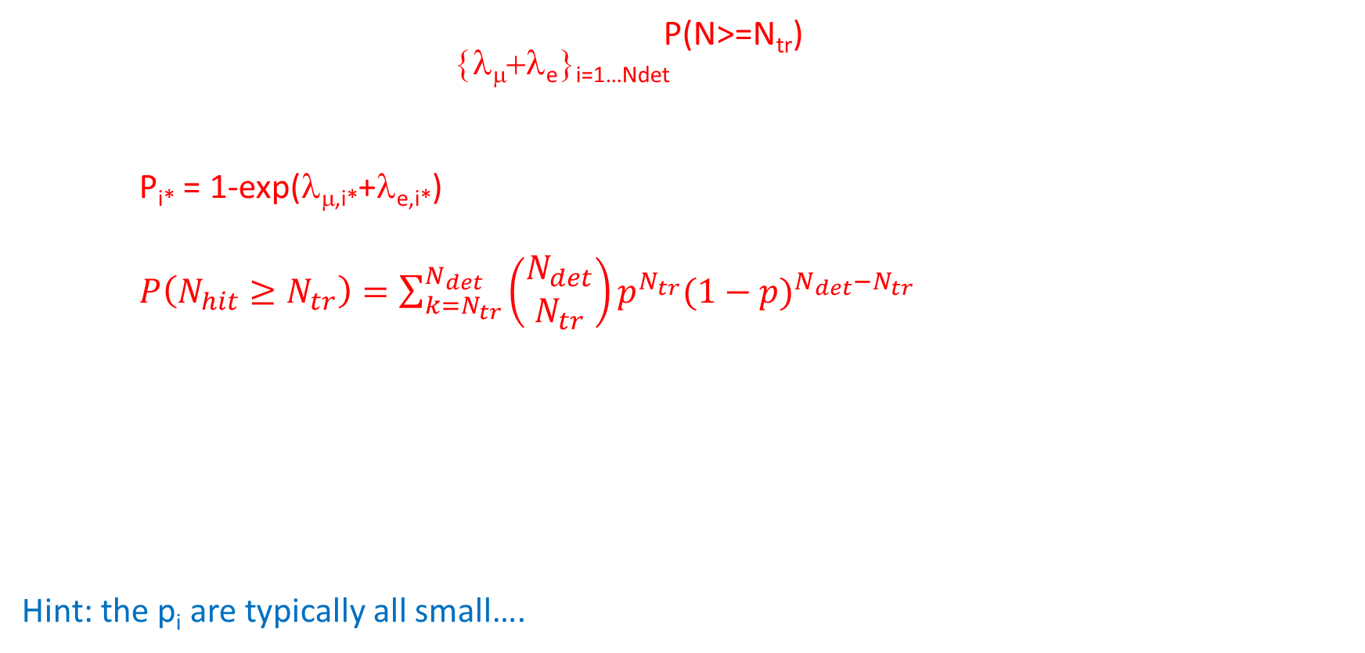
What we need
We need to come up with an expression for P(N>=N_{tr}) which depends on the expected flux at each detector i, i.e. the set {λ_{μ}+λ_{e}}_{i=1…Ndet}. Then we may substitute our estimates in place of expected fluxes.
For detector i*, the prob. of seeing at least one particle is
P_{i*} = 1-exp(λ_{μ,i*}+λ_{e,i*})
If all P_{i} were equal to p, the formula for P(N_{hit}>N_{tr}) would be something like
$P\left(N_{hit}≥N_{tr}\right)=\sum_{k=N_{tr}}^{N_{det}}{\left(\begin{matrix}N_{det} \\ N_{tr}\end{matrix}\right)p^{N_{tr}}{(1−p)}^{N_{det}−N_{tr}}}$
But the P_{i} are all different…. The generalization of the above formula is computationally heavy and complex.
Maybe you can come up with a (simple to compute, differentiable) formula that does it? This will allow us to compute dP/dx_{i*}, dP/dy_{i*} for any unit i*, and include that term in the derivative of the utility.
Approximations are welcome if they are not too rough. In principle, all that matters is that the P derivatives have the right sign…
Hint: the p_{i} are typically all small….

Slide 11
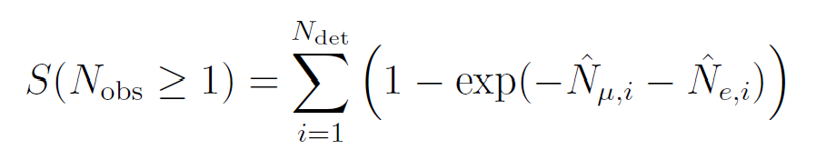
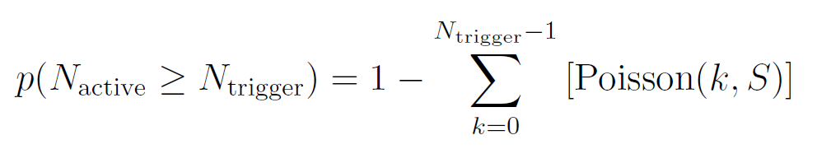
The preprint solution
Presently the code uses the fact that most pi’s are typically small when the triggering is uncertain, so we sum these:
We can then obtain

Slide 12
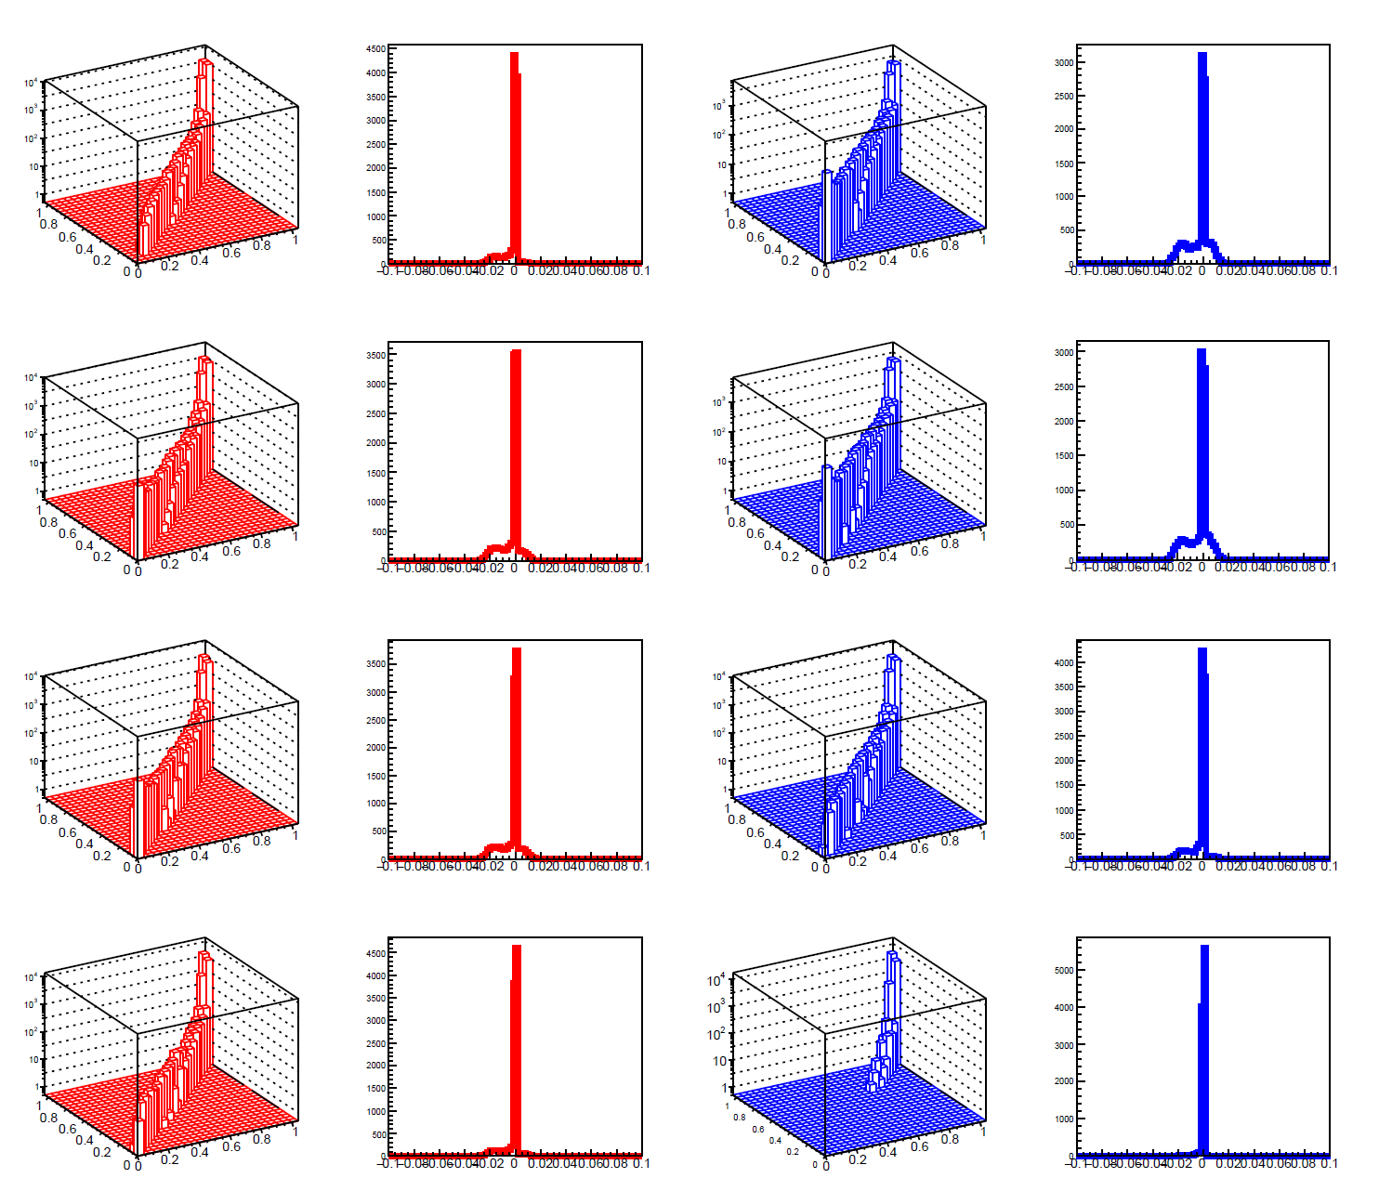
The preprint solution
Presently the code uses the fact that most pi’s are typically small when the triggering is uncertain, so we sum these:
We can then obtain
The approximation works reasonably well in most of the
phase space of interest (above, correlations with true
values obtained by resampling are shown, with residuals)

Slide 13
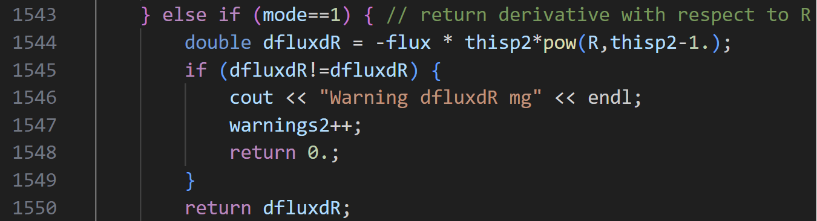
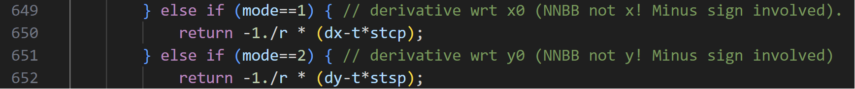
More detail
The code includes routines that compute the fluxes λ as well as their derivatives with respect to the position, dx (or dy).
If we include P_{tr} in U₂, dU/dx now requires (in addition to the other pieces) computing dU₂/dP_{tr} dP_{tr}/dx, which requires computing
dP_{tr}/dx = dP_{tr}/dλ dλ/dR dR/dx.
dP_{tr}/dλ is part of our problem, to address once we have a suitable way to compute P_{tr}.
If you come up with a good approximation, you can study it by comparing it to the true value…
The snipped below, which computes dλ/dR,
is available in the four
mfromg, efromg, mfromp, efromp routines:
dR/dx is also readily available:

Slide 14
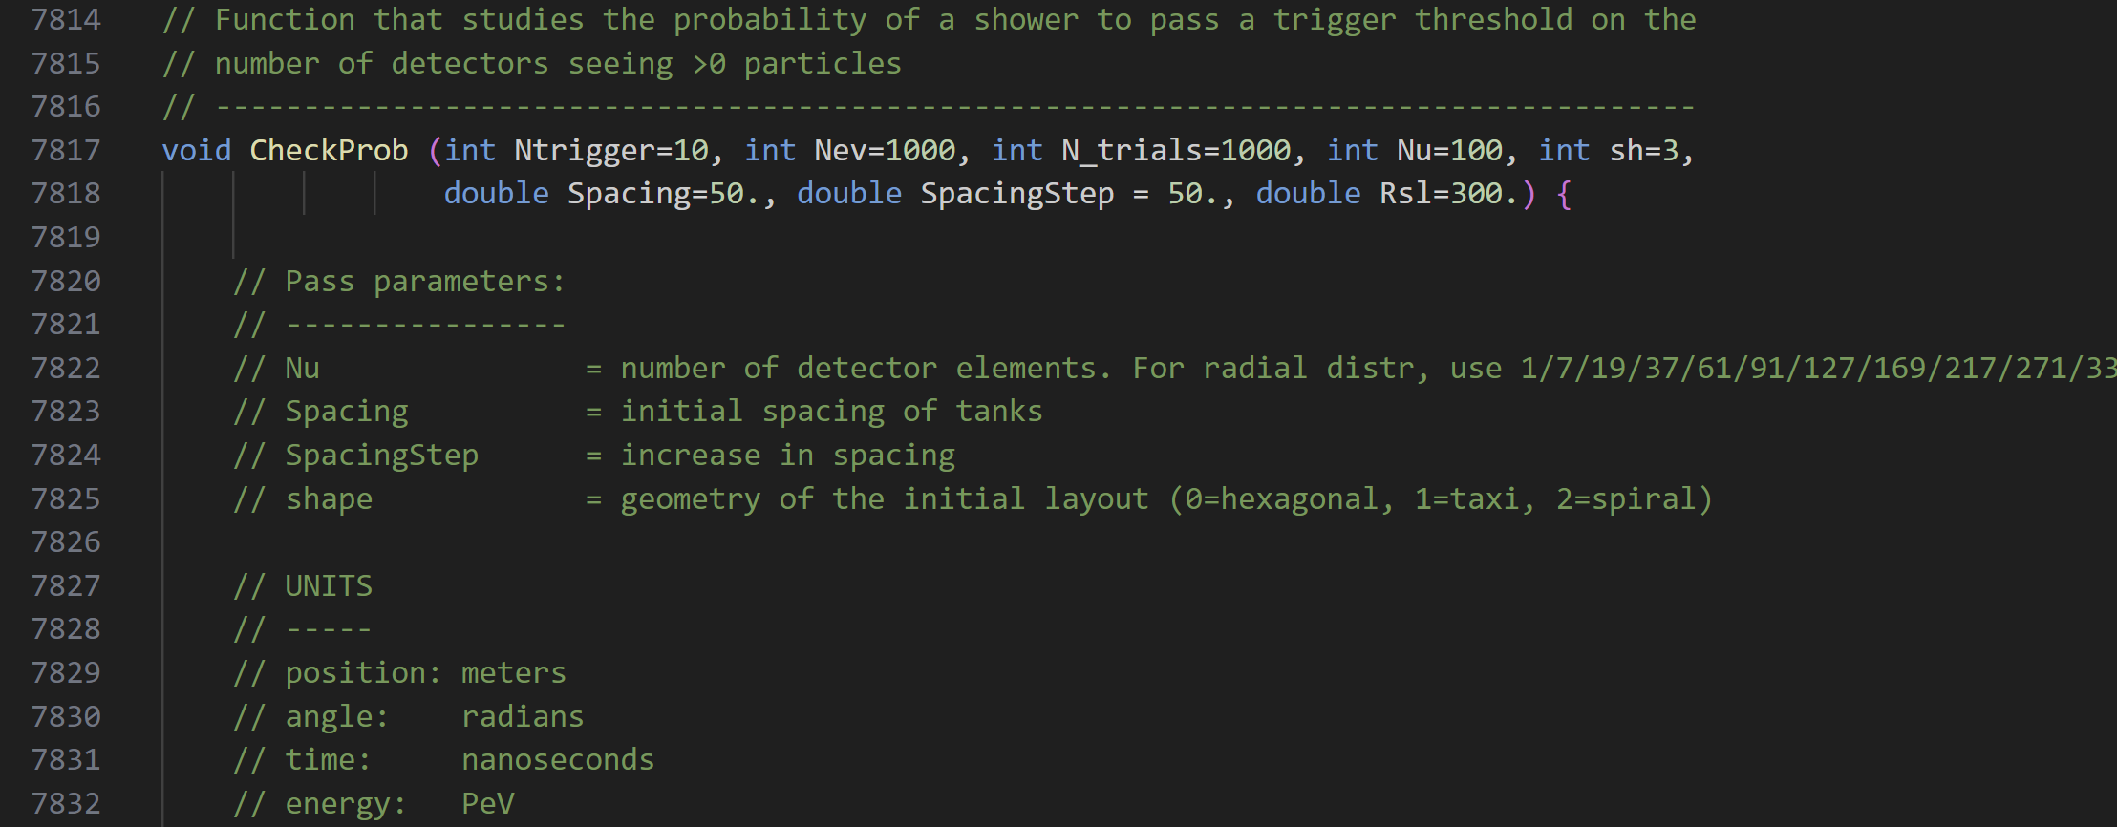
CheckProb()
The swgolo76.C code contains a routine (at the end) that exploits the shower model and can study different detector configurations and triggering conditions, and provide resampling estimates of P_{tr}, to be compared with what you can come up with.
Just add the calculation of your approximation and check the linearity in the graphs.
You can also keep track of the computing time (e.g. if you implement the exact calculation) and RMS of the residuals, to check how well you are doing

Slide 15
Downloading the code
You can download the swgolo76.C file from:
https://cernbox.cern.ch/s/MduNSb0FFTeuQvj
At these locations you can also get the two model files:
https://cernbox.cern.ch/s/NpPul7IIBzcmygd
https://cernbox.cern.ch/s/QppKHBEuZqIyNbY
You might also be interested in downloading the relevant arXiv preprint:
https://cernbox.cern.ch/s/gN8VNUa1FNuOUJg

Slide 16
A second (offline) challenge for you
In addition to asking you to reproduce (or find an alternative solution to) a result I already have, I am going to challenge you to contribute to the project by adding something to it!
The problem will be to use the Delta method to estimate the variation of the likelihood ratio test statistic (log of likelihood maxima for the gamma and proton hypotheses) AND to produce c++ code that performs the calculation
Among those who come up with a solution and produce code that works, I will select the best and most complete one, and add the winner to the author list of a SWGO article we are producing on our optimization work!

Slide 17
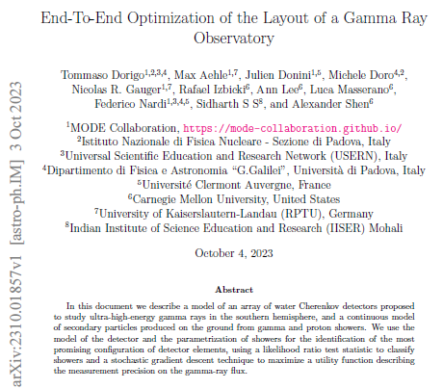
The SWGO preprint
We did publish a preprint of the article already, but now we are improving the calculations, extending the utility definition, and we plan to send to a peer-reviewed journal in February-March 2024.
As I explain below, you could join us as one of the authors of the final publication…

Slide 18
The likelihood ratio
To distinguish gamma from proton showers we
Maximize the likelihood of observed detector counts given shower parameters, under the gamma hypothesis
This returns L_{max, γ} [X_{0γ},Y_{0γ},θ_{γ},φ_{γ},E_{γ}]
Do the same for the proton hypothesis, obtain
L_{max, p} [X_{0p},Y_{0p},θ_{γp},φ_{γp},E_{γp}]
Then we take the logs, compute the difference
T = log(L_{max, γ}) – log(L_{max, p})
Note: the 5 parameters that maximize the two likelihoods are estimates, and they are different for the two hypotheses!

Slide 19
The problem: estimate σ_{LR}
In the pipeline I have put together (next slide for reference), I need to compute derivatives of the utility function U with respect to detector positions x_{i}, y_{i}
U depends on the uncertainty on the flux, which depends on the precision with which we estimate the fraction of photons in a mixture; the latter depends on how different the likelihood ratio distribution of proton and photon hypotheses are; and the LR depends on the position of detectors with respect to the shower centers, in a batch of showers we are using for batch gradient descent:
U = F(σ_{fγ}) = F(σ_{fγ}(LR)) = F(σ_{fγ}(LR(λ)) =
= F(σ_{fγ}(LR(λ_{γ}(R),λ_{p}(R)))) =
= F(σ_{fγ}(LR(λ_{γ}(R(x_{i},y_{i}; X_{0γ};Y_{0γ})), λ_{p}(R(x_{i},y_{i}; X_{0p};Y_{0p})))))
Above, I have specified that the LR depends on the fluxes λ that a gamma or a proton would produce on a detector situated at position x_{i},y_{i}
Plus angular dependencies

Slide 20
Simulate an initial layout for detector array
Stop when satisfied
Update layout (x,y of each tank) following gradient of U
Obtain the utility and its gradient with respect to each detector x,y position
Use RCF bound to estimate the expected variance of the signal flux measurement
Compute the likelihood of the observed batch as a function of the fraction of gammas in the batch; compute the second derivative of the likelihood
Simulate a set of gamma and proton showers hitting array
Reconstruct shower parameters ω in each hypothesis by likelihood maximization
Derive log-likelihood ratio of the two hypotheses
Obtain PDFs of LLR for the gamma and proton hypotheses given current layout
Simulate a batch of gammas and protons and reconstruct them; obtain the TS of each shower

Slide 21

The likelihoods
The likelihood ratio is a difference of logarithms of two likelihoods of a shower in a batch, each obtained as the maximum likelihood to see the observed muon and electron counts, {N_{μ},N_{e}}_{i} arriving at times {T_{μ},T_{e}}_{i} in a set of detectors i=1…N_{D} in the considered hypothesis (gamma, proton).
For a shower k, each of the two likelihoods can be written:
$$L\left(X_{0},Y_{0},θ,φ,E|{\left\{N_{μ},N_{e},T_{μ},T_{e}\right\}}_{k}\right)=\prod_{i=1}^{N_{D}}{\left\{Pois\left(N_{μ}|λ_{μ}\left(R\right)\right)Pois\left(N_{e}|λ_{e}\left(R\right)\right)G\left(T_{μ}−t,σ_{t}\right)G\left(T_{e}−t,σ_{t}\right)\right\}}$$
where the radii R are the distances of the i-th detector center to the shower axis ESTIMATED for the given hypothesis; and where times t are the ESTIMATED times of arrival of particles to the detector position, under the given hypothesis and given the estimated shower parameters.

Slide 22

The Delta method
The delta method consists in applying in matrix mode the error propagation formulas.
Let us consider two variables only, x,y:
we define a vector of gradients of the log-likelihood function ln L(x,y) as
$∇\ln{L\left(x,y\right)=\left(\frac{∂lnL(x,y)}{∂x},\frac{∂lnL(x,y)}{∂y}\right)}$
and the inverse of the Fisher information matrix, defined as J, the inverse of the negative Hessian:
$J=−H^{−1}=−{\left[\begin{matrix}\frac{∂^{2}L}{∂x^{2}} & \frac{∂^{2}L}{∂x∂y} \\ \frac{∂^{2}L}{∂x∂y} & \frac{∂^{2}L}{∂y^{2}}\end{matrix}\right]}^{−1}$

Slide 23
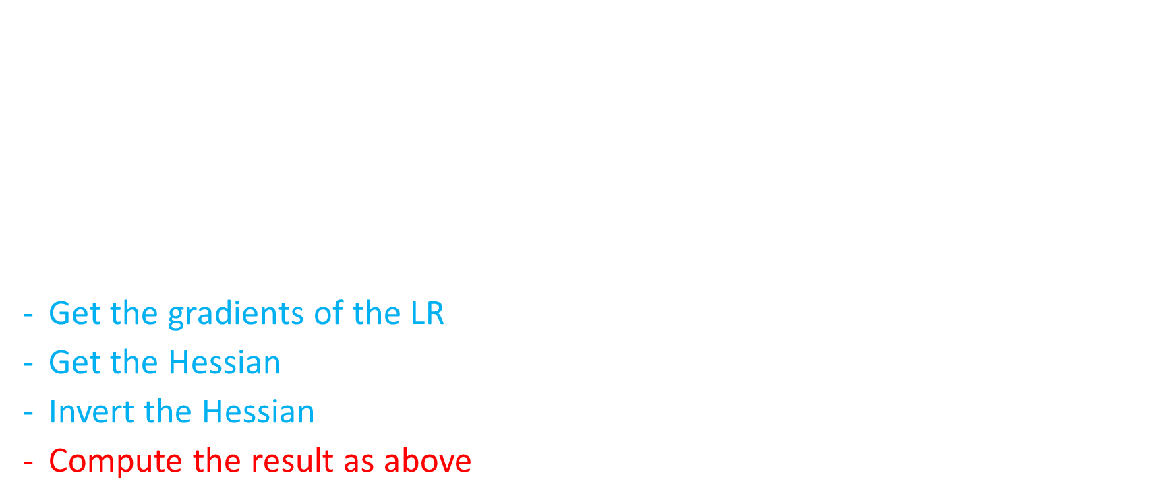
The result
Once we have those ingredients (we obtain gradients of the LR by subtracting the two gradients of the two lnL values), we directly get:
$$σ_{LR}=\sqrt{{∇\left(lnLR\right)}^{T}J∇(lnLR)}$$
So to estimate σ_{LR}, the problem can be broken down into three parts:
Get the gradients of the LR (you combine those of the two lnL terms)
Get the Hessian in the same way
Invert the Hessian, get J
Compute the result as above.

Slide 24
Something is already there…
You will not have to compute the radius R as a function of the detector positions and shower axis (it involves some trigonometry); this is already present in the code and accessible as a call to a function. The same is true for the expected arrival time of the particles (see next slide).
The same functions, if one provides an appropriate number among the pass parameters, provide derivatives of R or t as a function of the parameters of interest.
The same is true for the fluxes of muons and electrons from proton or gamma showers, λ: they are provided, along with their derivatives, by calls to four different functions.

Slide 25
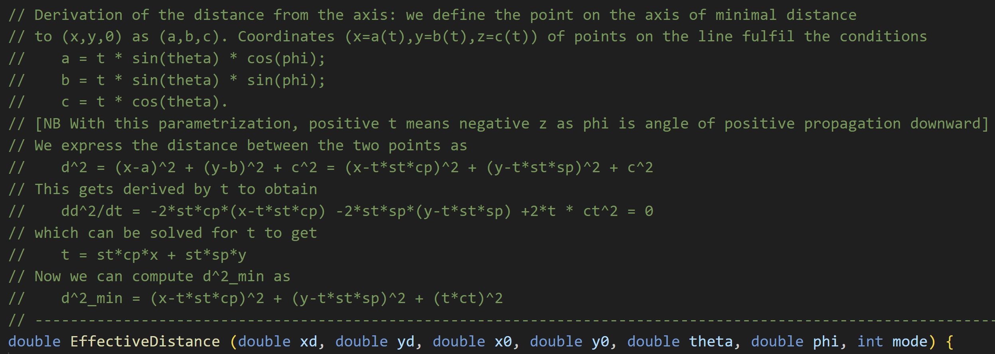
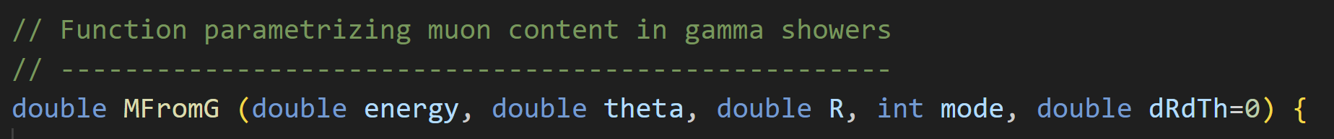
The functions

Slide 26
What you need to compute
The lnL of each of the two hypotheses (γ, p) is a sum of logs of Poisson and Gaussian terms. For each detector and for a given species of secondary particle (μ,e), we have terms like
lnL += -λ + N ln λ – ln N! + ½ [(T-t)/σ_{t}]²
and then of course LR = lnL_{γ} - lnL_{p}
In order to feed the Delta method, we need to compute first derivatives of lnL_{γ} and lnL_{p} over the 5+5 MLE of the shower parameters, to get the gradient terms; and then to compute again derivatives of all the five expressions over all parameters a second time, to get the Hessian terms. There are 60 distinct terms in total for a 10x10 Hessian matrix, but only 15 + 15 are non-null.
To get e.g. d lnLR/dX_{p} we need to use the chain rule of partial derivatives, as lnLR depends on X_{p} through changing R in the flux λ_{p}, so
dlnLR/dX_{p} = (sum over dets) [- dlnL_{p}/dλ ∗ dλ/dR * dR/dX + dlnL_{p}/dt * dt/dR * dR/dX]
This looks easy, but when you put together all pieces things get cumbersome…

Slide 27
Coding it up
I provide the code that does the full optimization and instructions on how to install and run it in the following slides
Then coding it in c++ requires you to find proper libraries for the inversion of a 5x5 matrix, and to code the calculations in a way that integrates well in the code.
So let us look into that.

Slide 28
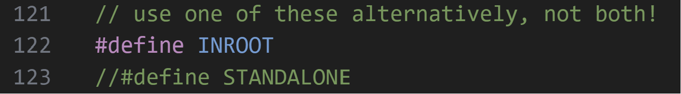
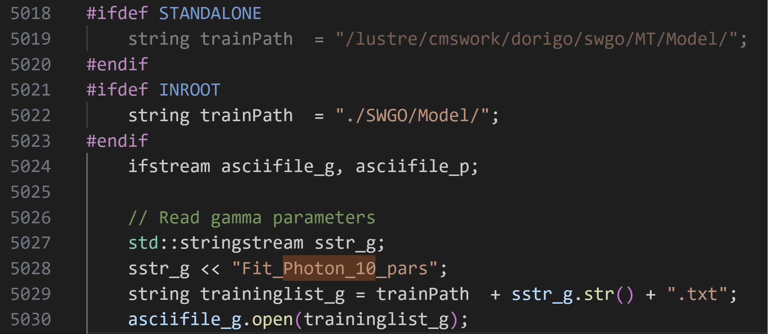
All you need to run the code
The code can run as a compiled root macro (but only in root 5!) OR as a standalone c++ code. A preprocessing directive allows to switch from one to the other seamlessly at the start of the code (beware, these MUST NOT have spaces at the beginning of the line):
The code looks for two .txt files in specified
directories, which contain the model of the
showers for photons and protons:
- fit_photon_10_pars.txt
- fit_proton_2_pars.txt
You need to modify all instances of the directory path where files are located, to those of your own root installation OR to your local disk (if working with standalone c++ code).

Slide 29
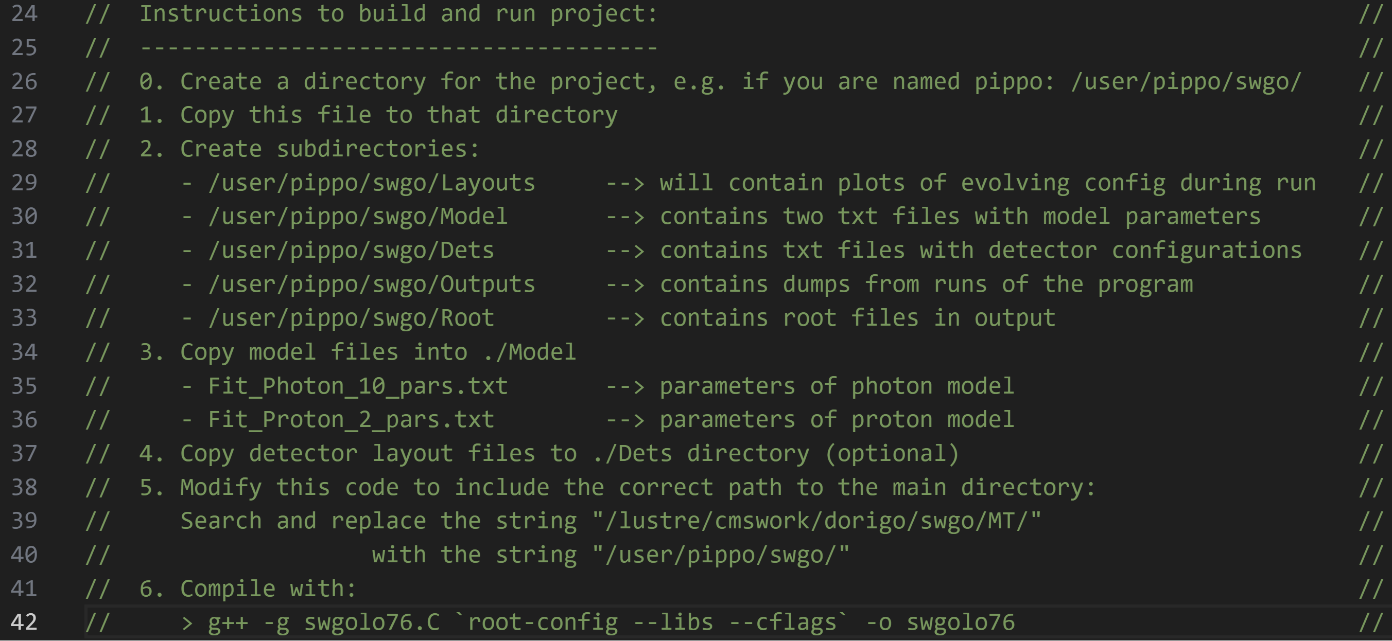
Instructions for the standalone version
Because the INROOT way of running requires root 5 (root discontinued windoze support from v6), I suggest you work with the standalone version. Here are all instructions:

Slide 30
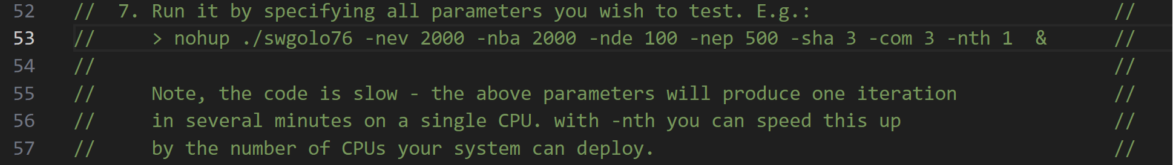
More instructions
Once you have created the directory path, changed all directory names in the code to those of your computer system, populated the ./Model subdirectory with the two model files, and compiled the code, you are ready to run it.
There are however a large number of parameters that determine the behaviour of the code. For the sake of testing the calculations of the delta method, and compare results, we might agree on three sets of parameters, of increasing complexity.
Below is the command one may use to run the program (nohup prevents abort if you log off, and the parameter choices specified below are just an example).

Slide 31
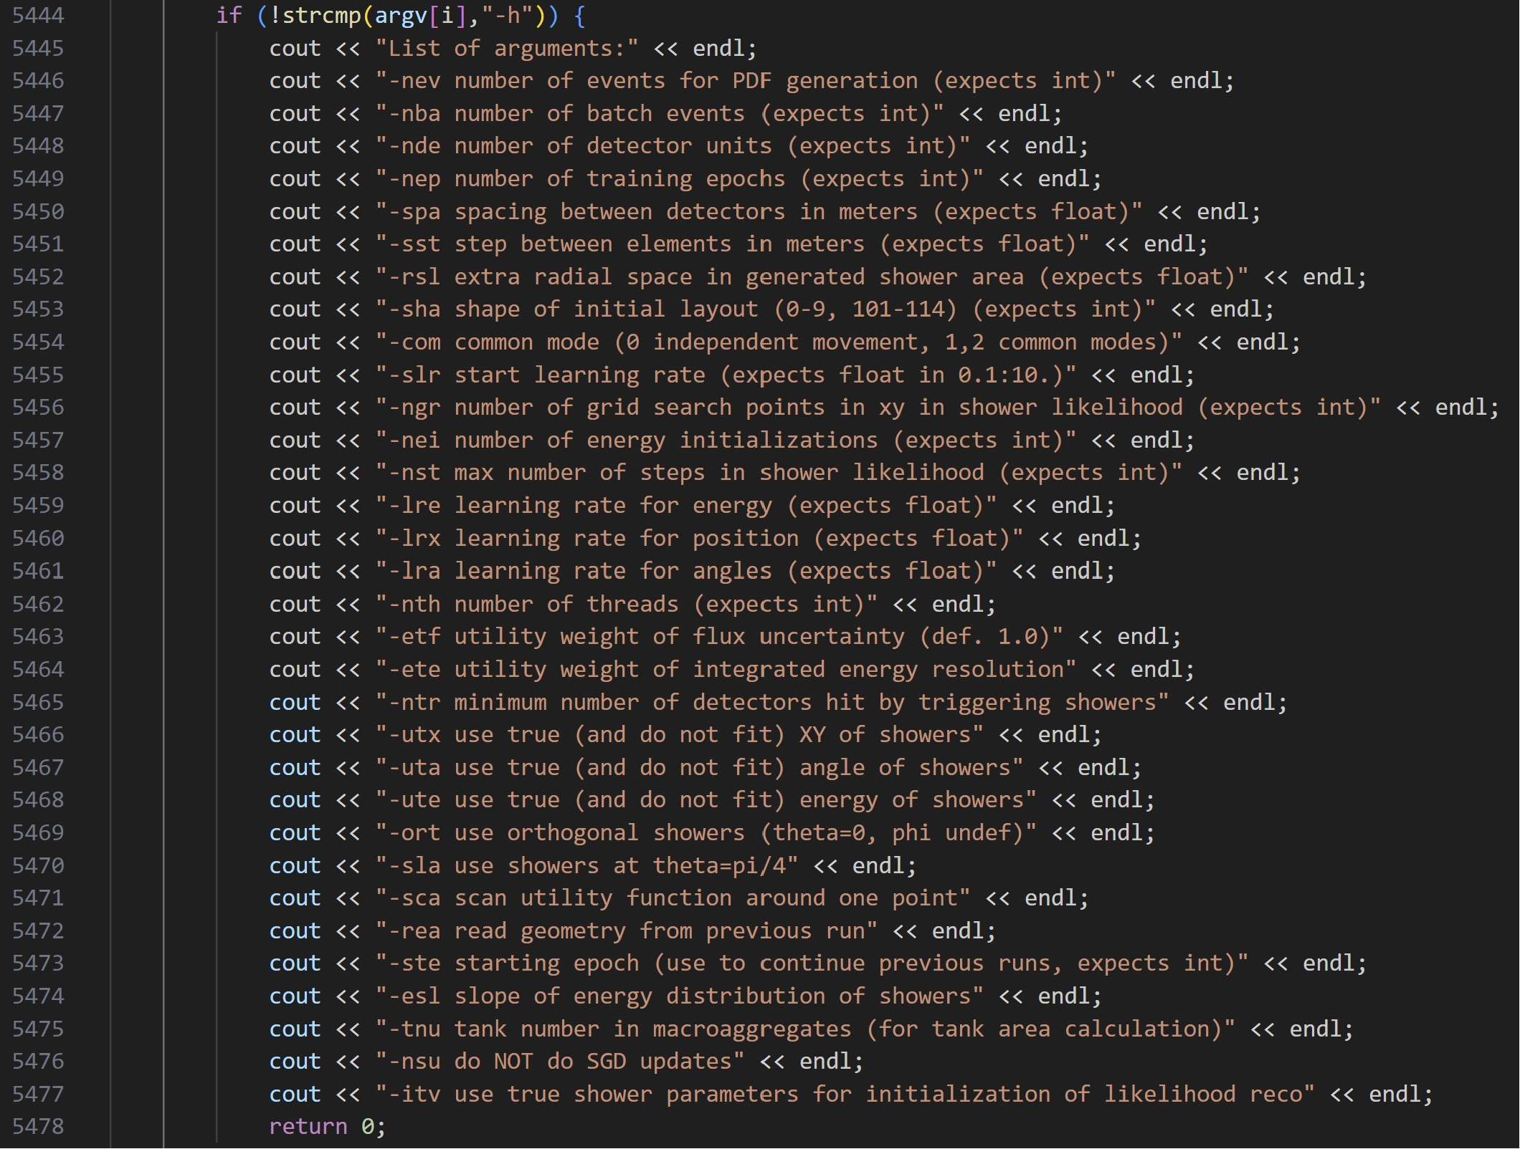
Parameters of the code
On the right are shown all parameters that can be passed by the command line, with a minimal explanation.
You can also do
swgolo76 –h
to get a dump from the command line.

Slide 32
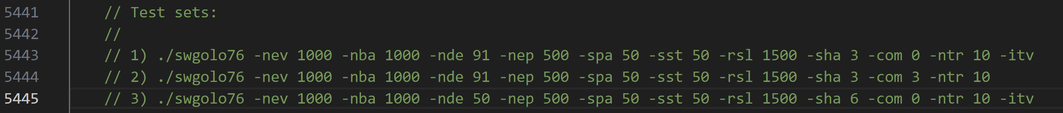
Suggested sets for testing of delta method
While we can check how the program works
with different approximations for sigma_LR,
its output will not tell us much about the precision.
I suggest that you come up with a way to verify
the accuracy of sigma_LR by resampling the Poisson variates N_{m}, N_{e} in each detector, and recomputing the LR many times, getting the variance of the result, then computing the relative difference,
sigma_LR()-sigma_LR(resampl)/sigma_LR(resampl)
The delta method should provide a better approximation of the LR variance than what exists in the code. Hence we should test it by running the original version and the modified one on parameter sets which can gauge the difference. Below are three proposed sets.

Slide 33
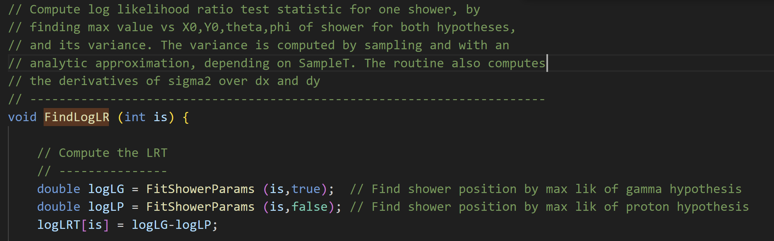
Details of the code
The routine you are asked to write replaces this one (cont’d to next slides):

Slide 34
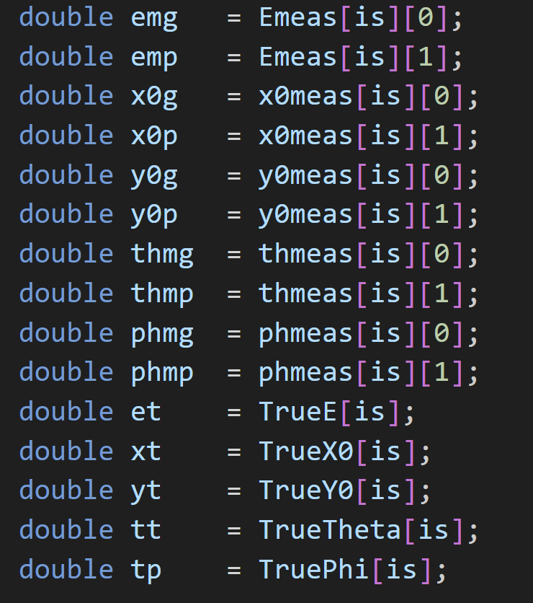
Details of the code / 2
The measured shower parameters are static doubles
(Emeas, x0meas, y0meas, thmeas, phmeas)
and they have indices defining the shower number, is,
and the hypothesis, 0=gamma, 1=proton.
You might also need the true shower parameters, also static.
This code snippet is useful as we need speed, and defining non-array
values inside the routine speeds calculations up.

Slide 35
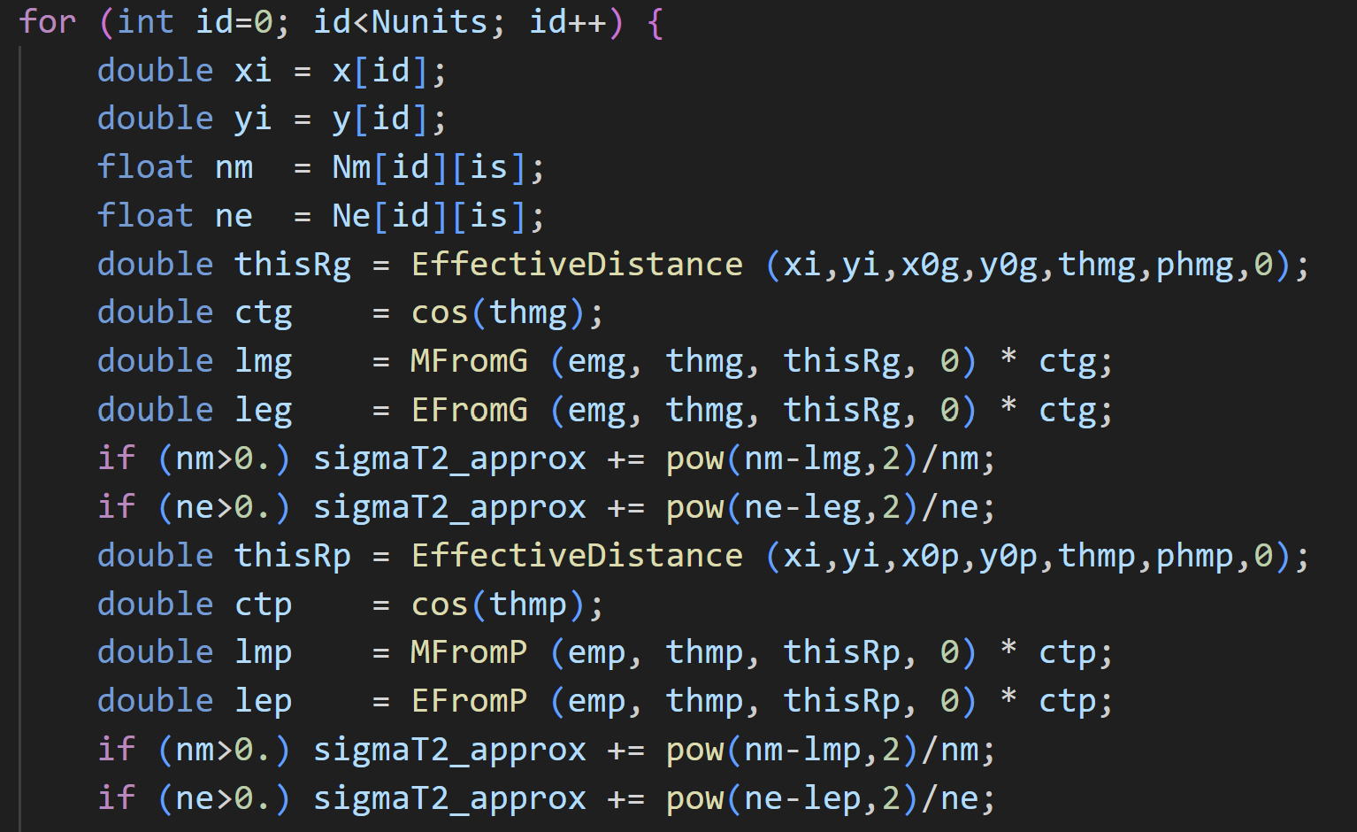
Details of the code / 3
The derivatives are evaluated by
summing over all detectors, so there
will be for loops from id=0 to id=Nunits
Like in this example, one first has to
determine what the number of particles
and times measured in each detector are,
and then compute the fluxes that are
predicted for the current distance of the
detector from the assumed shower
position (the estimated one!)
Nm[id][is], Tm[id][is] and the electron observables
are also static floats in the code

Slide 36
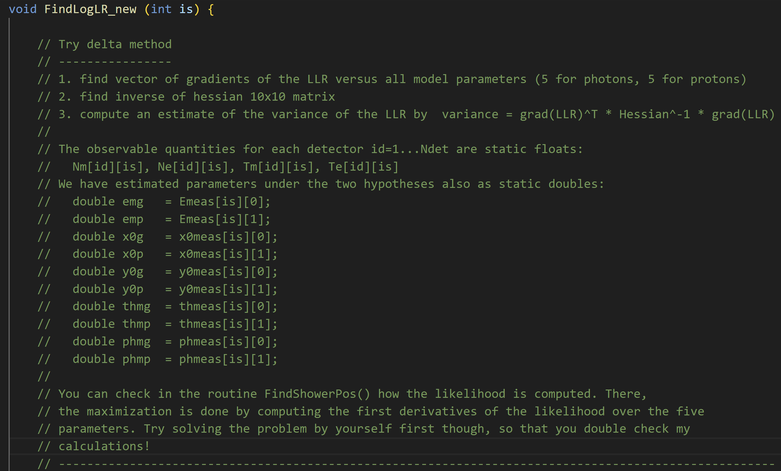
There is already a placeholder in the code…

Slide 37
Things to deliver
A table with the first and second derivatives fully computed
A routine integrated in the code, with comments describing all parts of the calculation (in the style of those already present)
Once ready, to try it you need to rename it to FindLogLR(int is) and rename the old one to FindLogLR_old(int is)
Be aware that to also work in multithreading (-nth 2 or larger), it must not modify static variables other than those with the index being worked on [is]
Plots of comparison of the computed sigma(LLR) in TH2D scatterplots, versus in turn the other two estimates that the present code computes, for the three specific use cases

